Slide 1
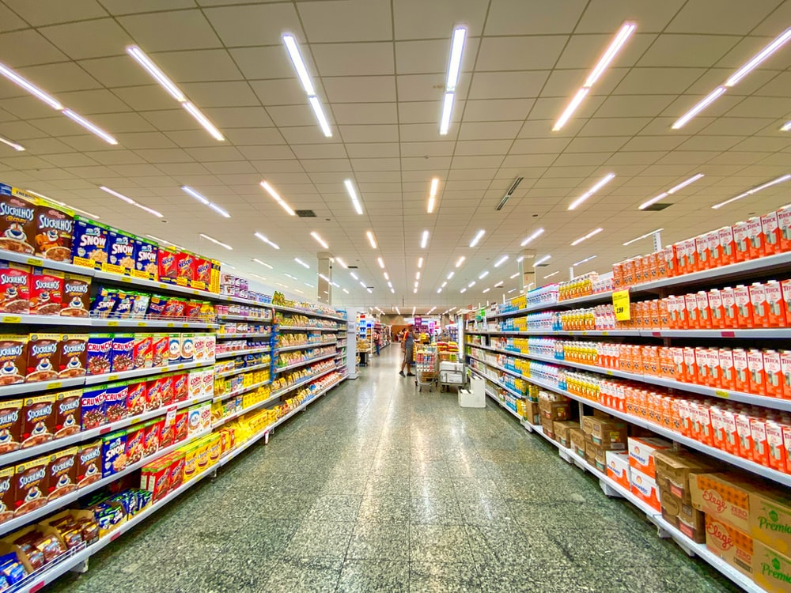
Machine Learning Advance Project
Grocery Shopping Data Analsysis
Learner :Ulka Patil Insaid : September 2019 cohort

Slide 2
Table of Content
1. Introduction
2. Data description
3. Data Profiling
4. Data Analysis
5. Model Evaluation (Apriori Algorithm)
6. Conclusion

Slide 3
Introduction
Affinity analysis is a data analysis and data mining technique that discovers co-occurrence relationships among activities performed by (or recorded about) specific individuals or groups. In general, this can be applied to any process where agents can be uniquely identified and information about their activities .
Why to analyze super market/grocery data
Marketing campaigns and promotions
Pricing
Inventory management

Slide 4
Data description
Here, the data represents the items a customer bought at a particular time at shopping center. Dataset contains 33 columns and 9835 rows where each row represents the number of items purchased and names of items in each respective columns.
Neglect 'NAN' in columns because if a customer bought 3 items then next 29 columns will be empty (null or NAN).
This is the groceries data with the list of items bought by customers. From the left side is the number of items in a basket then Item 1, 2, 3, etc stands for list of the items. Distribution of number of items sold in each transaction is displayed after the most frequent items. We can see 2,159 transactions only included a single item. The largest item set included 32 items.

Slide 5
Data Profiling
Dataset statistic
Number of variables 33
Number of observations 9835
Missing cells 271353
Missing cells (%) 83.6%
Duplicate rows 2824
Duplicate rows (%) 28.7%
Total size in memory 2.5 MiB
Average record size in memory 264.0 B
Variable types
CATEGORICAL (32)
NUMERICAL (1)

Slide 6
Data Analysis
The goal here is to apply Apriori algorithm on the dataset and see the rules. Below mentioned is the simple explanations of them:
Support
Confidence
Lift
We can see most frequent times occurred in dataset. Whole milk was the most popular item sold with 2,513 units followed by other vegetables.
333 combinations of shopping are suggested by Apriori algorithms.
Distribution of number of items sold in each transaction is displayed after the most frequent items. We can see 2,159 transactions only included a single item. The largest item set included 32 items.

Slide 7
Model Evaluation (Apriory Algorithm)
Apriori is an algorithm for frequent item set mining and association rule learning over relational databases. It proceeds by identifying the frequent individual items in the database and extending them to larger and larger item sets as long as those item sets appear sufficiently often in the database.
Item | Rule | Frequency | Reliability
0 | (whole milk,) | 0.255516 | 0.255516
8 | [other vegetables, whole milk] | 0.074835 | 0.386758
9 | [whole milk, other vegetables] | 0.074835 | 0.292877
10 | [rolls/buns, whole milk] | 0.056634 | 0.307905
11 | [whole milk, rolls/buns] | 0.056634 | 0.221647
12 | [yogurt, whole milk] | 0.056024 | 0.401603

Slide 8
Conclusion
Algorithms are showing that , from this dataset 'Whole Milk' is the most selling item.
‘Whole Milk' and items under category 'vegetables'
'Whole Milk' and items under category 'rolls/buns'
'Whole Milk' and items under category 'yogurt'
These three combination can be considered for deciding marketing technique for discounts on most selling product combinations. Building the Apriori algorithm and implementing it in Association Rule Mining on a general grocery dataset from a supermarket can be used by this business segment? What are the priority areas, for example? Based on research, this is what we at Express Analytics.
Express Analytics is useful for
Promotions
Shopper targeting
Marketing Campaign Management
Pricing
Inventory management

Slide 9
Thank You!

